Slide 1

Spring of Code
Artificial Intelligence
(Machine Learning & Deep Learning)
Instructor
Asad Ullah
- Research Assistant (DIP Lab)
Duration
03 Months
(Feb – April)

Slide 2
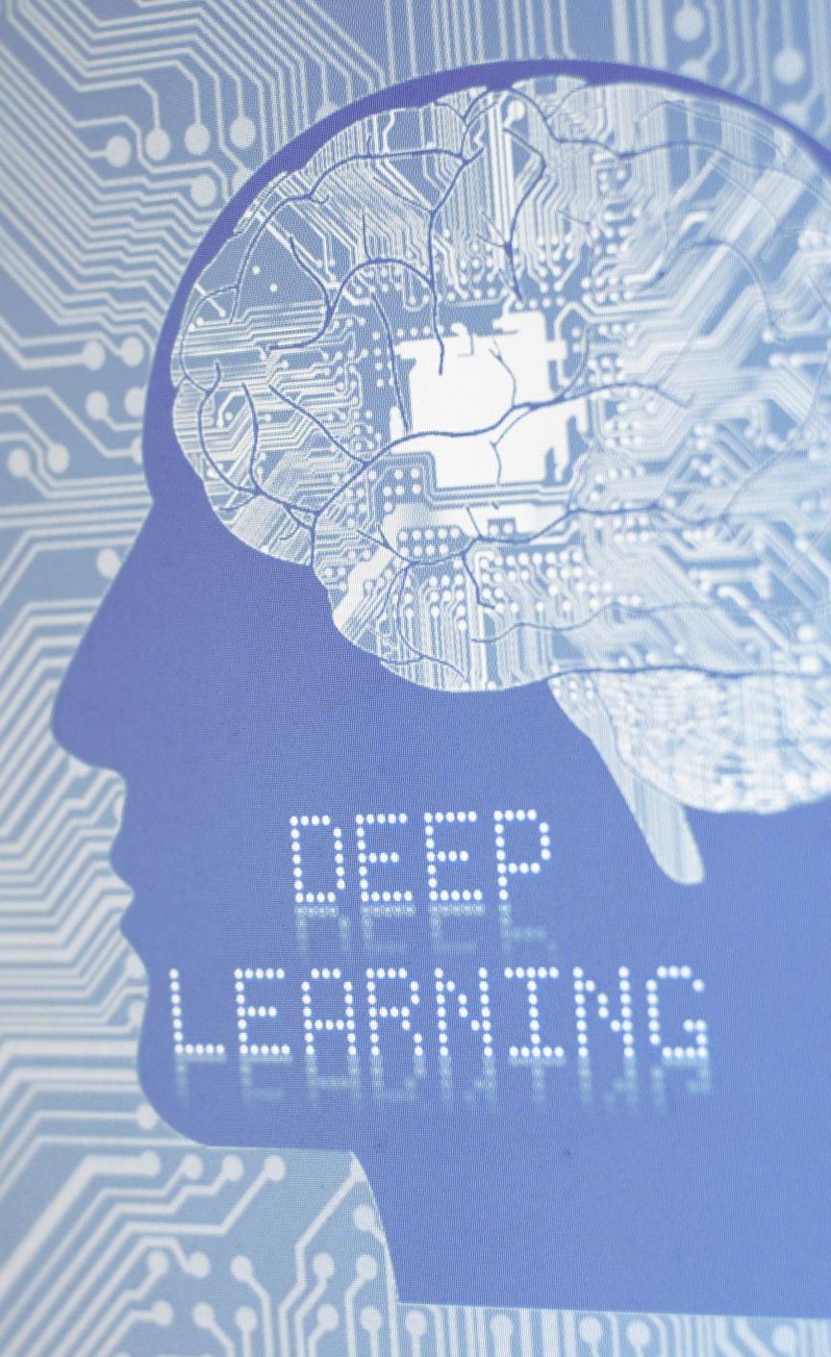
Day 04 – Introduction to RNNs
(Recurrent Neural Networks)
Objectives:
What is RNNs
Why we use RNNs
Architecture of RNNs
Application of RNNs

Slide 3
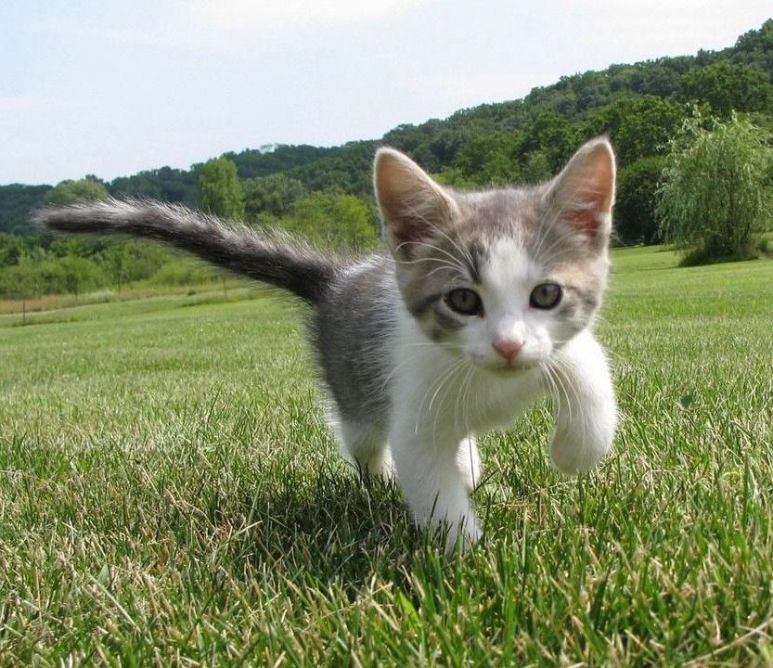
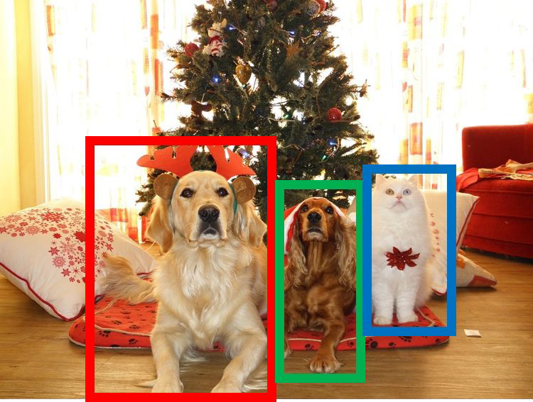
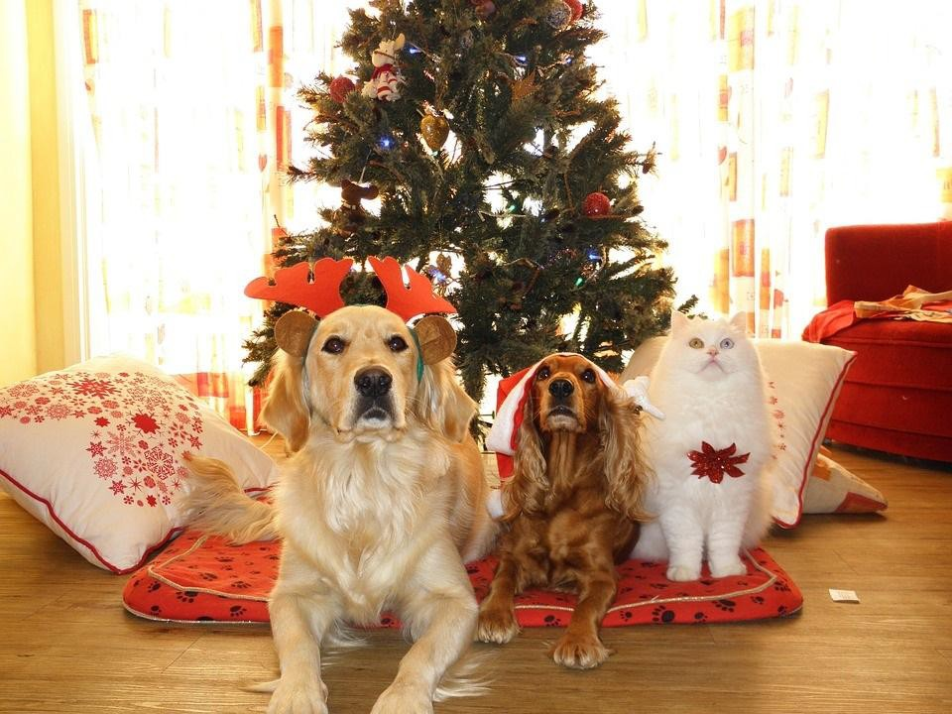
Last time: Detection and Segmentation
Semantic Segmentation
Object Detection
Instance Segmentation
Classification
CAT
GRASS, CAT, TREE, SKY
DOG, DOG, CAT
DOG, DOG, CAT
No spatial extent
No objects, just pixels
Multiple Objects
This image is CC0 public domain
Fei-Fei Li, Jiajun Wu, Ruohan Gao

Slide 4
Training “Feedforward” Neural Networks
One time set up: activation functions, preprocessing, weight initialization, regularization, gradient checking
Training dynamics: babysitting the learning process, parameter updates, hyperparameter optimization
Evaluation: model ensembles, test-time augmentation, transfer learning
Fei-Fei Li, Jiajun Wu, Ruohan Gao

Slide 5
Today: Recurrent Neural Networks
Fei-Fei Li, Jiajun Wu, Ruohan Gao

Slide 6
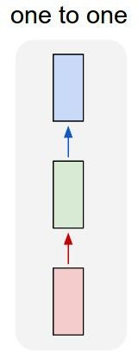
“Vanilla” Neural Network
Vanilla Neural Networks
Fei-Fei Li, Jiajun Wu, Ruohan Gao

Slide 7
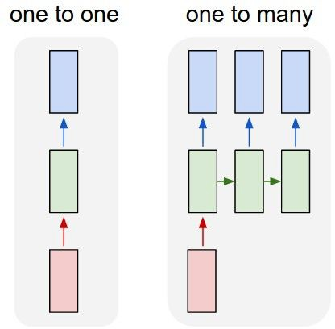
Recurrent Neural Networks: Process Sequences
e.g. Image Captioning
image -> sequence of words
Fei-Fei Li, Jiajun Wu, Ruohan Gao

Slide 8
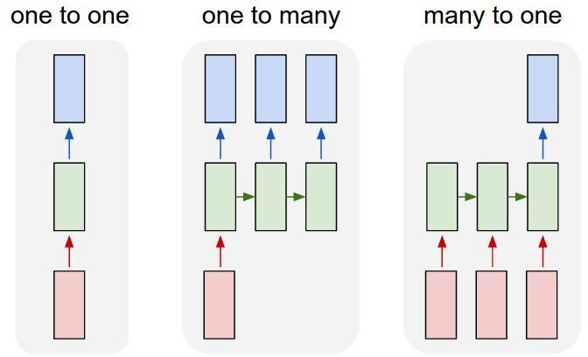
Recurrent Neural Networks: Process Sequences
e.g. action prediction
sequence of video frames -> action class
Fei-Fei Li, Jiajun Wu, Ruohan Gao

Slide 9
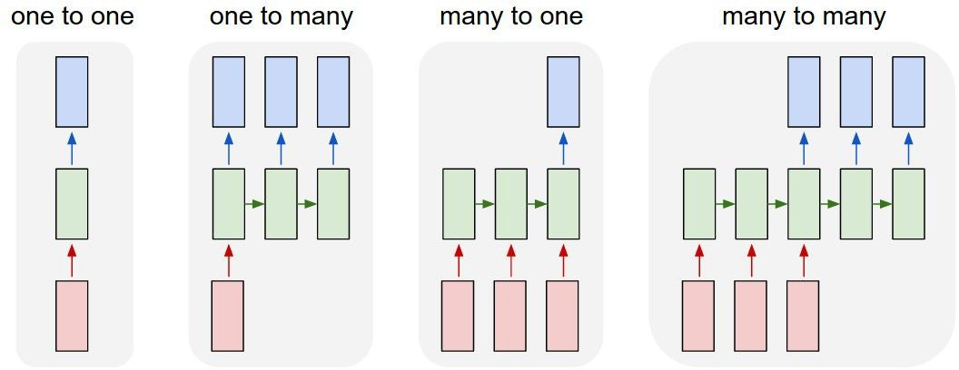
Recurrent Neural Networks: Process Sequences
E.g. Video Captioning
Sequence of video frames -> caption
Fei-Fei Li, Jiajun Wu, Ruohan Gao

Slide 10
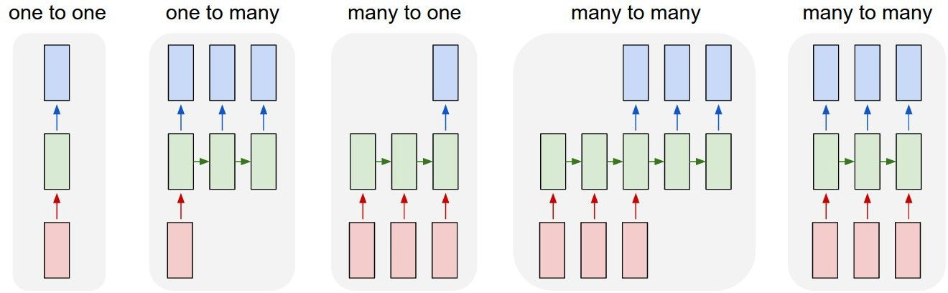
Recurrent Neural Networks: Process Sequences
e.g. Video classification on frame level
Fei-Fei Li, Jiajun Wu, Ruohan Gao

Slide 11
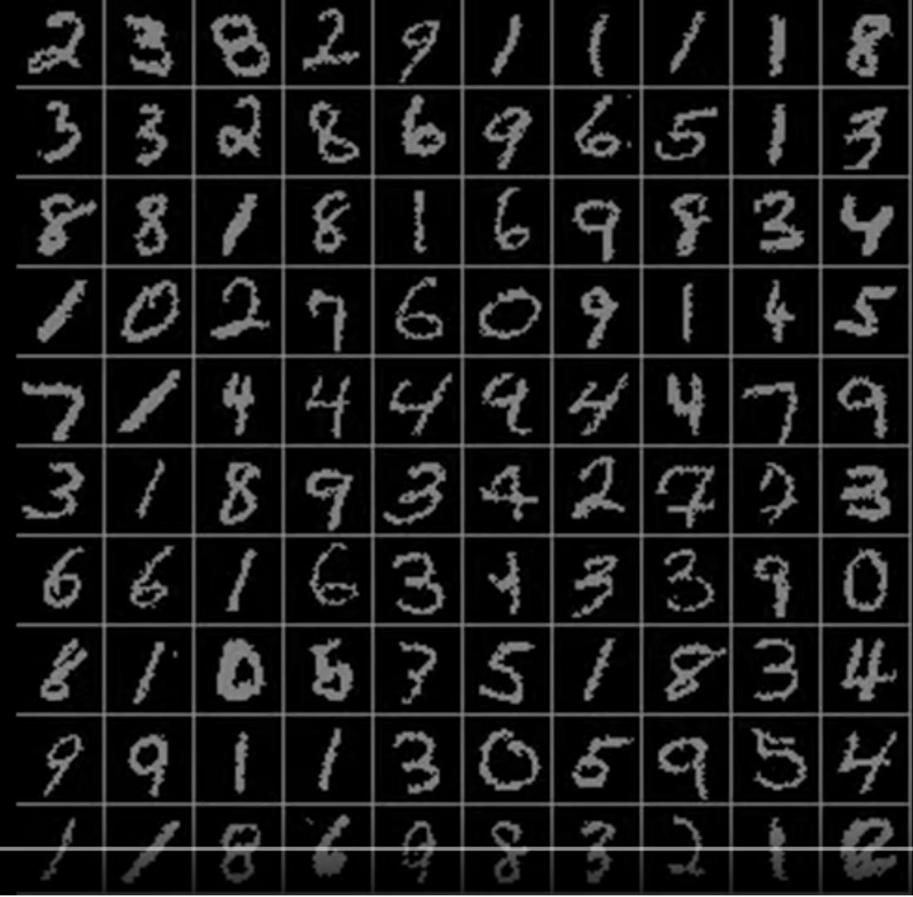
Sequential Processing of Non-Sequence Data
Classify images by taking a series of “glimpses”
Ba, Mnih, and Kavukcuoglu, “Multiple Object Recognition with Visual Attention”, ICLR 2015. Gregor et al, “DRAW: A Recurrent Neural Network For Image Generation”, ICML 2015
Figure copyright Karol Gregor, Ivo Danihelka, Alex Graves, Danilo Jimenez Rezende, and Daan Wierstra, 2015. Reproduced with permission.
Fei-Fei Li, Jiajun Wu, Ruohan Gao

Slide 12
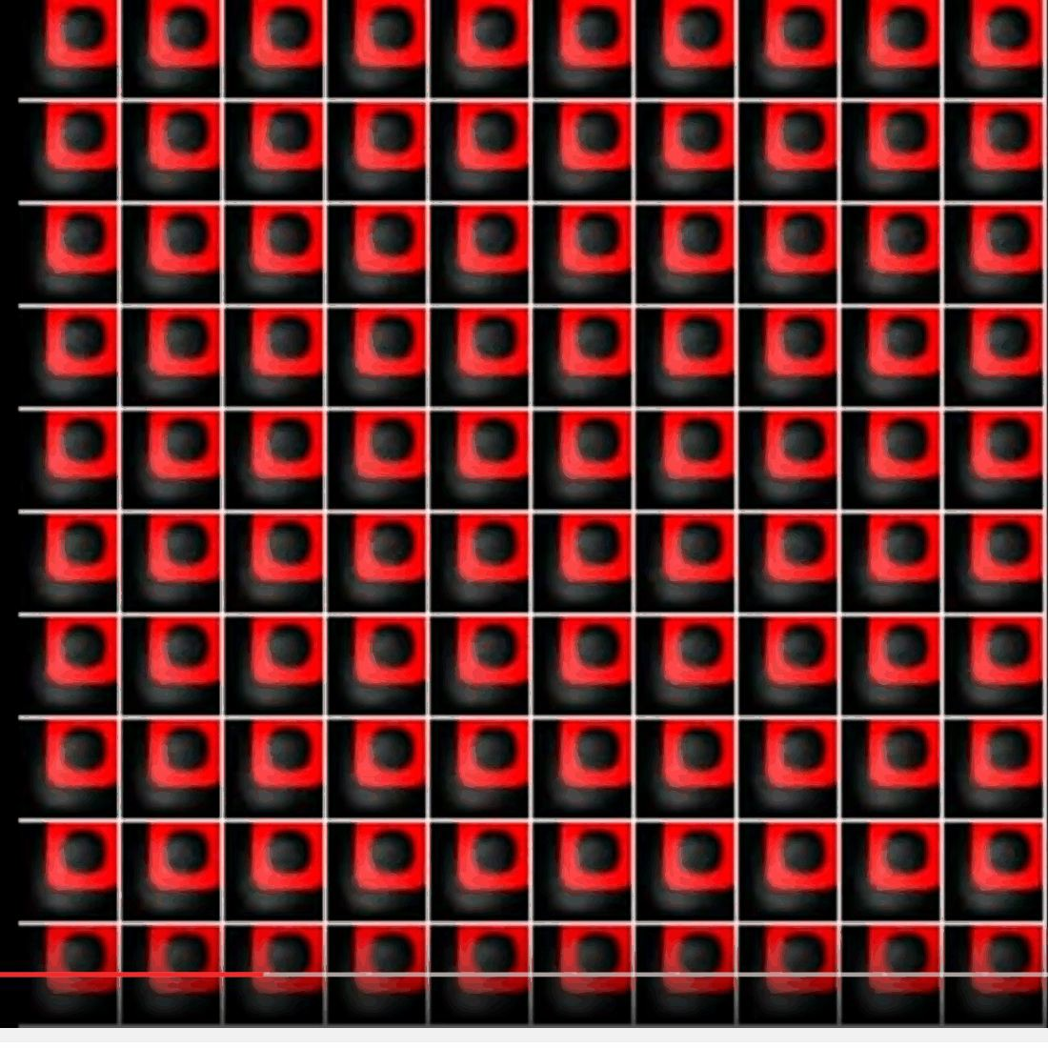
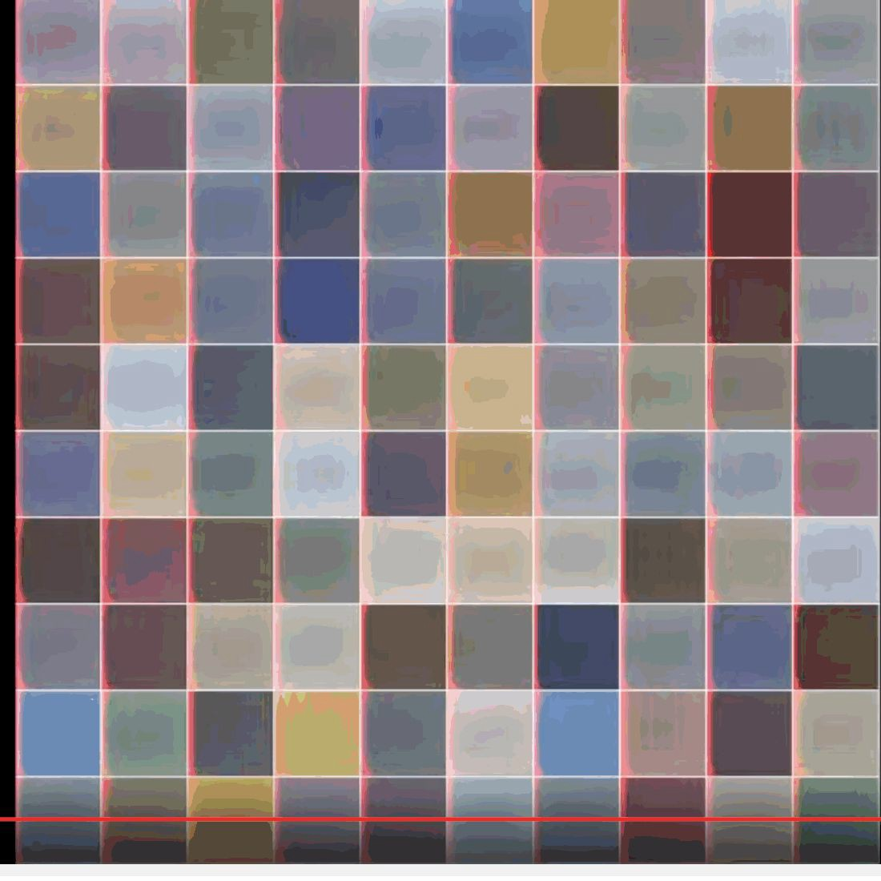
Sequential Processing of Non-Sequence Data
Generate images one piece at a time!
Gregor et al, “DRAW: A Recurrent Neural Network For Image Generation”, ICML 2015
Figure copyright Karol Gregor, Ivo Danihelka, Alex Graves, Danilo Jimenez Rezende, and Daan Wierstra, 2015. Reproduced with permission.
Fei-Fei Li, Jiajun Wu, Ruohan Gao

Slide 13
Recurrent Neural Network
y
RNN
x
Fei-Fei Li, Jiajun Wu, Ruohan Gao

Slide 14
Recurrent Neural Network
y
Key idea: RNNs have an “internal state” that is updated as a sequence is processed
RNN
x
Fei-Fei Li, Jiajun Wu, Ruohan Gao

Slide 15
Unrolled RNN
y₁
y₂
y₃
y_{t}
RNN
RNN
RNN
RNN
...
x₁
x₂
x₃
x_{t}
Fei-Fei Li, Jiajun Wu, Ruohan Gao

Slide 16

RNN hidden state update
We can process a sequence of vectors x by applying a recurrence formula at every time step:
y
RNN
new state old state input vector at
some time step
x
some function
with parameters W
Fei-Fei Li, Jiajun Wu, Ruohan Gao

Slide 17

RNN output generation
We can process a sequence of vectors x by applying a recurrence formula at every time step:
y
RNN
output
new state
x
another function with parameters W_{o}
Fei-Fei Li, Jiajun Wu, Ruohan Gao

Slide 18
Recurrent Neural Network
y₁
y₂
y₃
y_{t}
h₀
RNN
h₁
RNN
h₂
RNN
h₃
RNN
...
x₁
x₂
x₃
x_{t}
Fei-Fei Li, Jiajun Wu, Ruohan Gao

Slide 19
Recurrent Neural Network
We can process a sequence of vectors x by applying a recurrence formula at every time step:
y
RNN
x
Notice: the same function and the same set of parameters are used at every time step.
Fei-Fei Li, Jiajun Wu, Ruohan Gao

Slide 20

(Vanilla) Recurrent Neural Network
The state consists of a single “hidden” vector h:
y
RNN
x
Sometimes called a “Vanilla RNN” or an “Elman RNN” after Prof. Jeffrey Elman
Fei-Fei Li, Jiajun Wu, Ruohan Gao

Slide 21
RNN: Computational Graph
h₀
h₁
f_{W}
x₁
Fei-Fei Li, Jiajun Wu, Ruohan Gao

Slide 22
RNN: Computational Graph
h₀
h₁
h₂
f_{W}
f_{W}
x₁
x₂
Fei-Fei Li, Jiajun Wu, Ruohan Gao

Slide 23
RNN: Computational Graph
h₀
h₁
h₂
h₃
…
h_{T}
f_{W}
f_{W}
f_{W}
x₁
x₂
x₃
Fei-Fei Li, Jiajun Wu, Ruohan Gao

Slide 24
RNN: Computational Graph
Re-use the same weight matrix at every time-step
h₃
…
h_{T}
h₀
f_{W}
h₁
f_{W}
h₂
f_{W}
x₁
x₂
x₃
W
Fei-Fei Li, Jiajun Wu, Ruohan Gao

Slide 25
RNN: Computational Graph: Many to Many
y₁
y₂
y₃
y_{T}
h₃
…
h_{T}
h₀
f_{W}
h₁
f_{W}
h₂
f_{W}
x₁
x₂
x₃
W
Fei-Fei Li, Jiajun Wu, Ruohan Gao

Slide 26
RNN: Computational Graph: Many to Many
y₁
y₂
y₃
y_{T}
L₁
L₂
L₃
L_{T}
h₃
…
h_{T}
h₀
f_{W}
h₁
f_{W}
h₂
f_{W}
x₁
x₂
x₃
W
Fei-Fei Li, Jiajun Wu, Ruohan Gao
Lecture 10 - 28
April 28, 2022

Slide 27
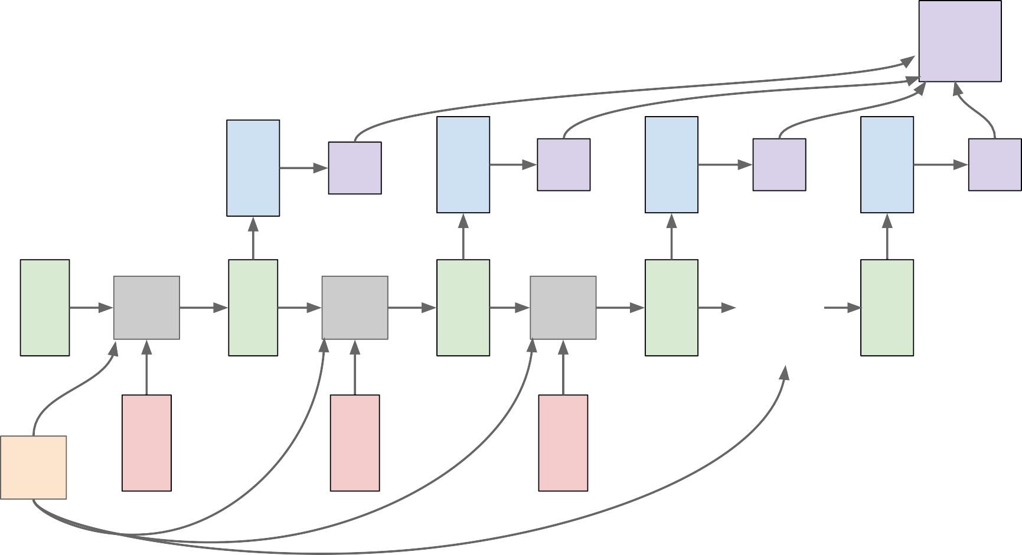
RNN: Computational Graph: Many to Many
L
y₁
L₁
y₂
L₂
y₃
L₃
y_{T}
L_{T}
…
h₀
f_{W}
h₁
f_{W}
h₂
f_{W}
h₃
h_{T}
x₁
x₂
x₃
W
Fei-Fei Li, Jiajun Wu, Ruohan Gao

Slide 28
RNN: Computational Graph: Many to One
y
h₃
…
h_{T}
h₀
f_{W}
h₁
f_{W}
h₂
f_{W}
x₁
x₂
x₃
W
Fei-Fei Li, Jiajun Wu, Ruohan Gao

Slide 29
RNN: Computational Graph: Many to One
y
h₃
…
h_{T}
h₀
f_{W}
h₁
f_{W}
h₂
f_{W}
x₁
x₂
x₃
W
Fei-Fei Li, Jiajun Wu, Ruohan Gao

Slide 30
RNN: Computational Graph: One to Many
y₁
y₂
y₃
y_{T}
h₃
…
h_{T}
h₀
f_{W}
h₁
f_{W}
h₂
f_{W}
x
W
Fei-Fei Li, Jiajun Wu, Ruohan Gao

Slide 31
RNN: Computational Graph: One to Many
y₁
y₂
y₃
y_{T}
h₃
…
h_{T}
h₀
f_{W}
h₁
f_{W}
h₂
f_{W}
x
?
?
?
W
Fei-Fei Li, Jiajun Wu, Ruohan Gao

Slide 32
RNN: Computational Graph: One to Many
y₁
y₂
y₃
y_{T}
h₃
…
h_{T}
h₀
f_{W}
h₁
f_{W}
h₂
f_{W}
x
0
0
0
W
Fei-Fei Li, Jiajun Wu, Ruohan Gao
Lecture 10 - 34
April 28, 2022

Slide 33
RNN: Computational Graph: One to Many
y₁
y₂
y₃
y_{T}
h₃
…
h_{T}
h₀
f_{W}
h₁
f_{W}
h₂
f_{W}
x
y₁
y₂
y
W
T-1
Fei-Fei Li, Jiajun Wu, Ruohan Gao

Slide 34
Sequence to Sequence: Many-to-one + one-to-many
Many to one: Encode input sequence in a single vector
h₀
h₁
h₂
h₃
…
h_{T}
f_{W}
f_{W}
f_{W}
x₁
x₂
x₃
W₁
Sutskever et al, “Sequence to Sequence Learning with Neural Networks”, NIPS 2014
Fei-Fei Li, Jiajun Wu, Ruohan Gao

Slide 35
Sequence to Sequence: Many-to-one + one-to-many
One to many: Produce output sequence from single input vector
Many to one: Encode input
sequence in a single vector
y₁
y₂
h₀
h₁
h₂
h₃
…
h_{T}
h₁
h₂
…
f_{W}
f_{W}
f_{W}
f_{W}
f_{W}
f_{W}
x₁
x₂
x₃
W₁
W₂
Sutskever et al, “Sequence to Sequence Learning with Neural Networks”, NIPS 2014
Fei-Fei Li, Jiajun Wu, Ruohan Gao

Slide 36
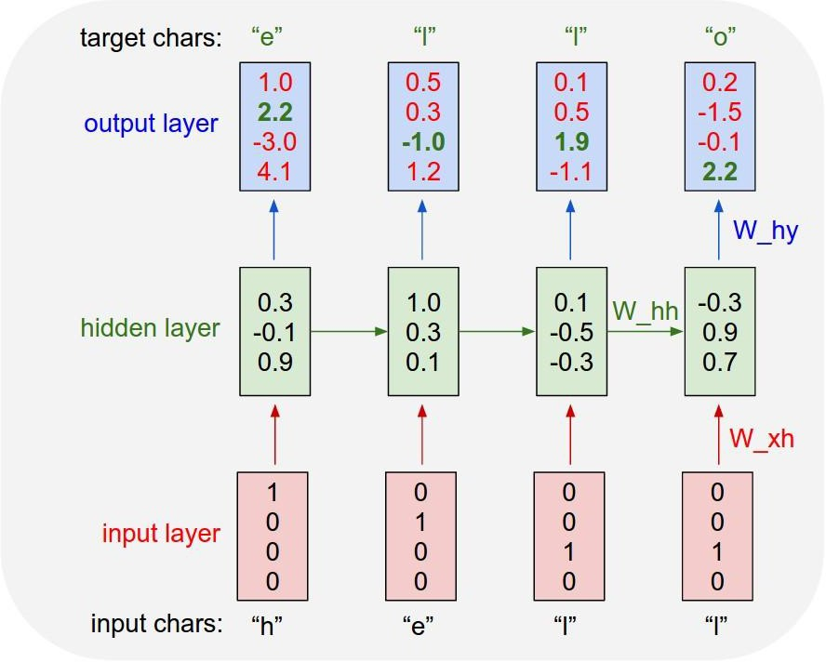
Example: Character-level Language Model
Vocabulary: [h,e,l,o]
Example training sequence: “hello”
Fei-Fei Li, Jiajun Wu, Ruohan Gao

Slide 37
Example: Character-level Language Model
Vocabulary: [h,e,l,o]
Example training sequence: “hello”
Fei-Fei Li, Jiajun Wu, Ruohan Gao
Lecture 10 - 39
April 28, 2022

Slide 38
Example: Character-level Language Model
Vocabulary: [h,e,l,o]
Example training sequence: “hello”
Fei-Fei Li, Jiajun Wu, Ruohan Gao

Slide 39
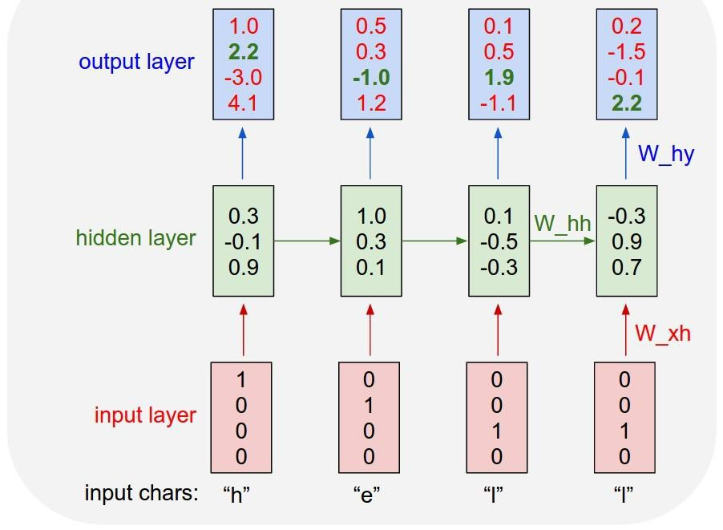
Example: Character-level Language Model Sampling
“e”
“l”
.25
.20
.05
.50
“l” “o”
.11 .11
.17 .02
.68 .08
.03 .79
Sample
.03
.84
.00
.13
Softmax
Vocabulary:
[h,e,l,o]
At test-time sample characters one at a time, feed back to model
Fei-Fei Li, Jiajun Wu, Ruohan Gao

Slide 40
Example: Character-level Language Model Sampling
“e”
“l”
.25
.20
.05
.50
“l” “o”
.11 .11
.17 .02
.68 .08
.03 .79
Sample
.03
.84
.00
.13
Softmax
Vocabulary:
[h,e,l,o]
At test-time sample characters one at a time, feed back to model
Fei-Fei Li, Jiajun Wu, Ruohan Gao

Slide 41
Example: Character-level Language Model Sampling
“e”
“l”
“l” “o”
.11 .11
.17 .02
.68 .08
.03 .79
Sample
.03
.84
.00
.13
.25
.20
.50
.05
Softmax
Vocabulary:
[h,e,l,o]
At test-time sample characters one at a time, feed back to model
Fei-Fei Li, Jiajun Wu, Ruohan Gao

Slide 42
Example: Character-level Language Model Sampling
“e” |  | “l” |  | “l” |  | “o”
.03 |  | .25 |  | .11 |  | .11
.84 |  | .20 |  | .17 |  | .02
.00 |  | .50 |  | .68 |  | .08
.13 |  | .05 |  | .03 |  | .79
Sample
Softmax
Vocabulary:
[h,e,l,o]
At test-time sample characters one at a time, feed back to model
Fei-Fei Li, Jiajun Wu, Ruohan Gao

Slide 43
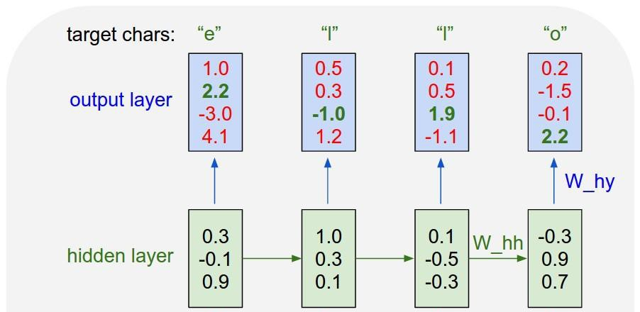
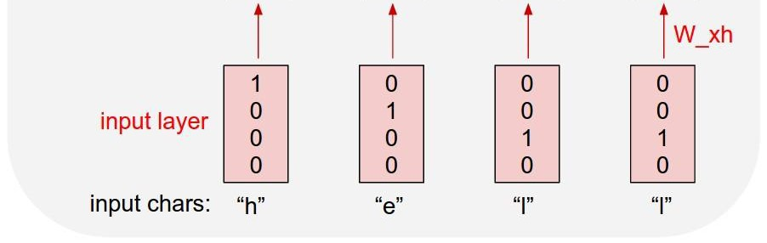
Example: Character-level Language Model Sampling
[w₁₁ w₁₂ w₁₃ w₁₄] [1] [w₁₁] [w₂₁ w₂₂ w₂₃ w₁₄] [0] = [w₂₁]
[w₃₁ w₃₂ w₃₃ w₁₄] [0] [w₃₁]
[0]
.03
.13
.00
.84
.25
.20
.05
.50
.11
.17
.68
.03
.11
.17
.68
.03
Embedding
layer
Matrix multiply with a one-hot vector just extracts a column from the weight matrix. We often put a separate embedding layer between input and hidden layers.
Fei-Fei Li, Jiajun Wu, Ruohan Gao

Slide 44


Backpropagation through time
Forward through entire sequence to compute loss, then backward through entire sequence to compute gradient
Loss
Fei-Fei Li, Jiajun Wu, Ruohan Gao

Slide 45
Truncated Backpropagation through time
Loss
Run forward and backward through chunks of the sequence instead of whole sequence
Fei-Fei Li, Jiajun Wu, Ruohan Gao

Slide 46
Truncated Backpropagation through time
Loss
Carry hidden states forward in time forever, but only backpropagate for some smaller number of steps
Fei-Fei Li, Jiajun Wu, Ruohan Gao

Slide 47
Truncated Backpropagation through time
Loss
Fei-Fei Li, Jiajun Wu, Ruohan Gao

Slide 48
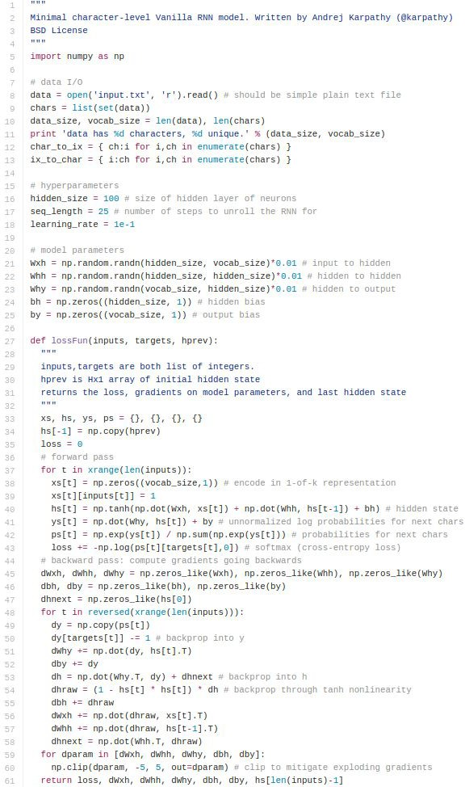
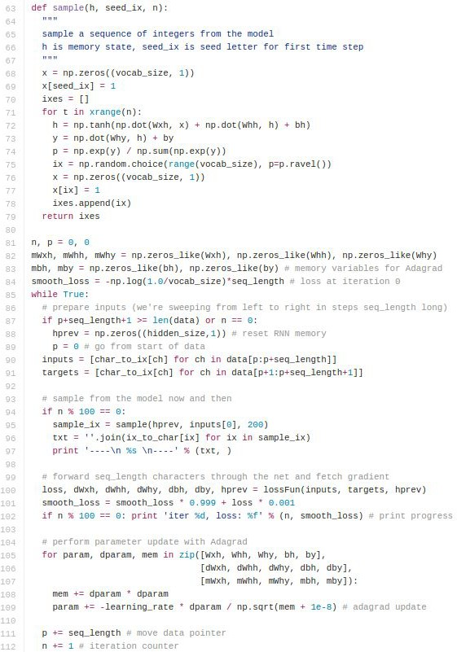
min-char-rnn.py gist: 112 lines of Python
(https://gist.github.com/karpathy/d4dee 566867f8291f086)
Fei-Fei Li, Jiajun Wu, Ruohan Gao

Slide 49
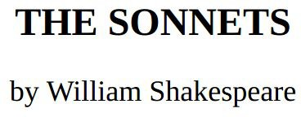
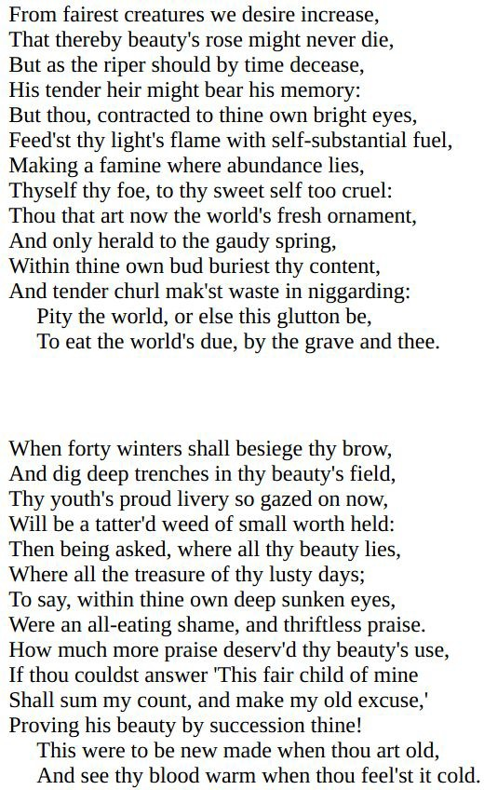
y
RNN
x
Fei-Fei Li, Jiajun Wu, Ruohan Gao

Slide 50
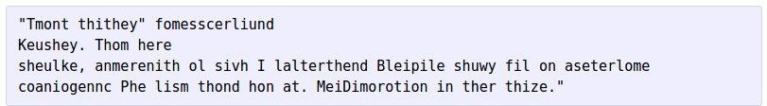


at first:
train more
train more
train more
Fei-Fei Li, Jiajun Wu, Ruohan Gao

Slide 51

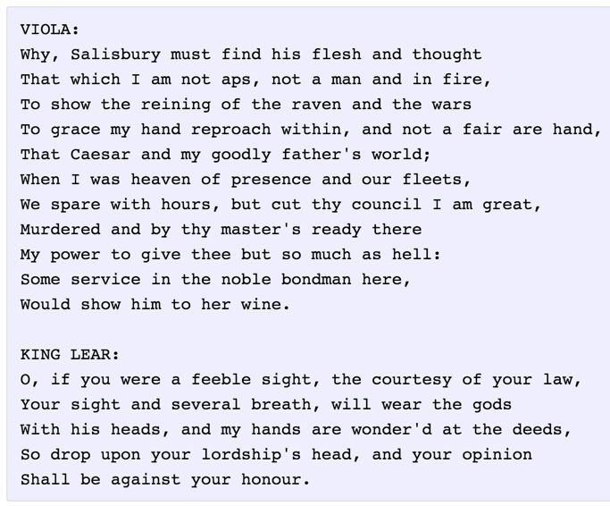
Fei-Fei Li, Jiajun Wu, Ruohan Gao

Slide 52
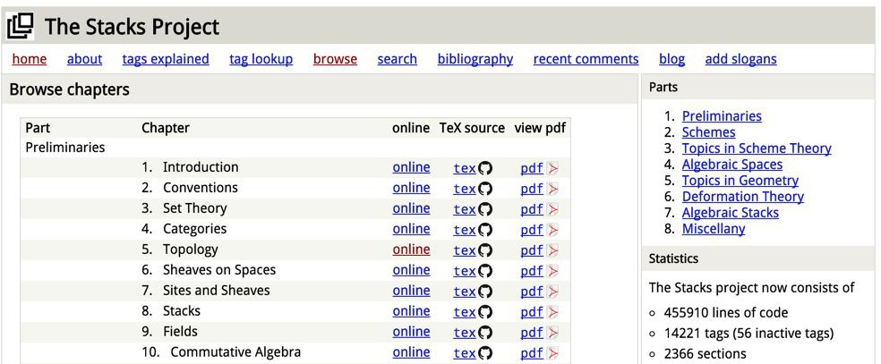
The Stacks Project: open source algebraic geometry textbook
Latex source
http://stacks.math.columbia.edu/
The stacks project is licensed under the GNU Free Documentation License
Fei-Fei Li, Jiajun Wu, Ruohan Gao

Slide 53
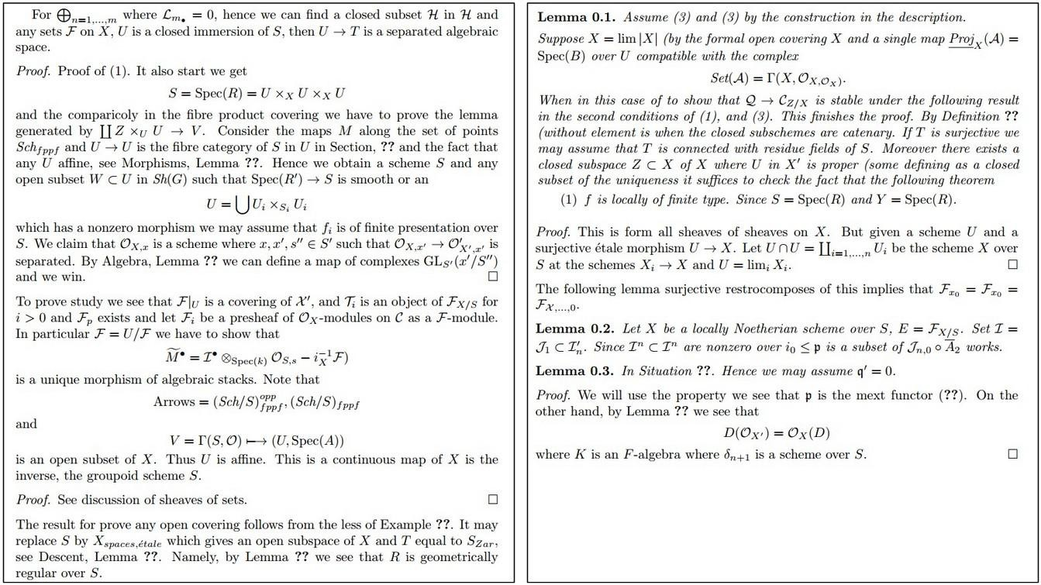
Fei-Fei Li, Jiajun Wu, Ruohan Gao

Slide 54
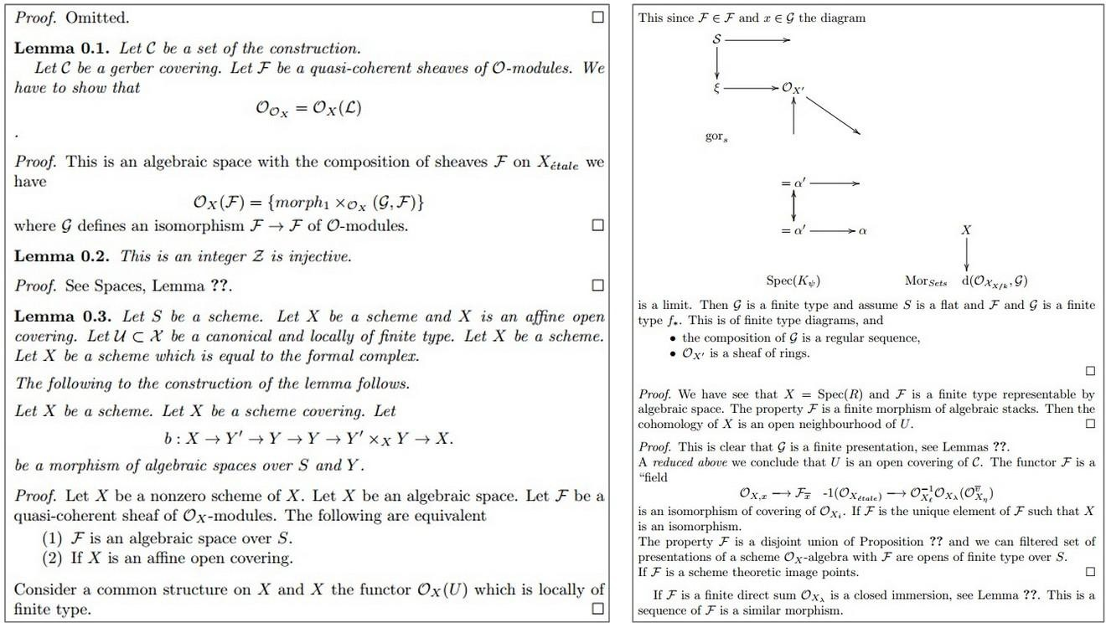
Fei-Fei Li, Jiajun Wu, Ruohan Gao

Slide 55
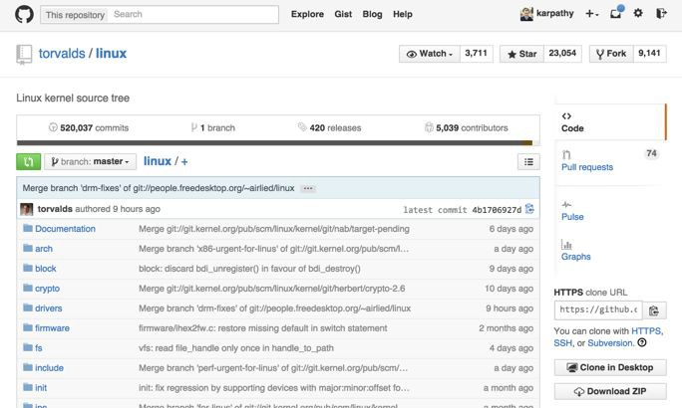
Fei-Fei Li, Jiajun Wu, Ruohan Gao

Slide 56
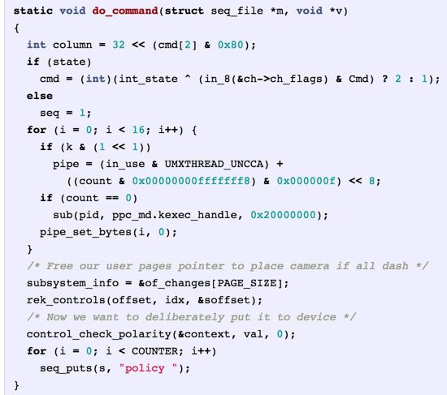
Generated C code
Fei-Fei Li, Jiajun Wu, Ruohan Gao

Slide 57
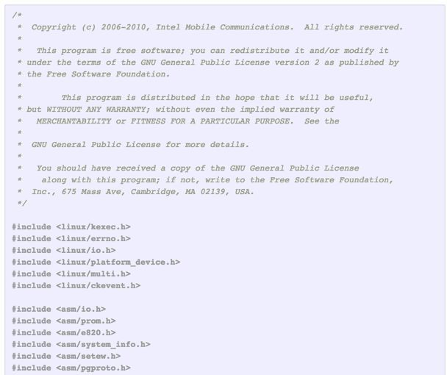
Fei-Fei Li, Jiajun Wu, Ruohan Gao

Slide 58
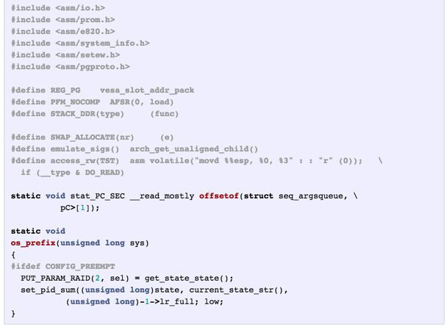
Fei-Fei Li, Jiajun Wu, Ruohan Gao

Slide 59

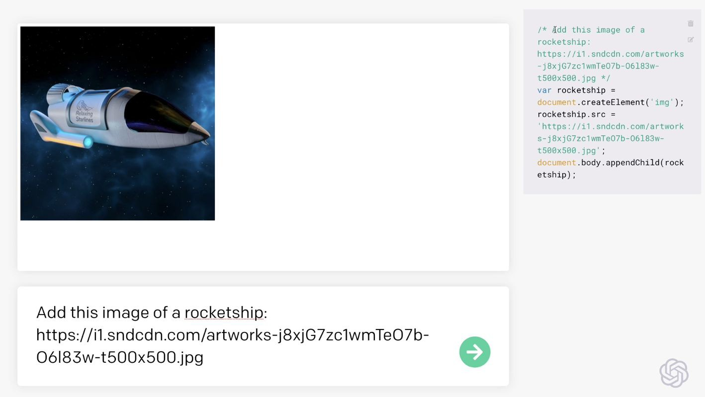
https://openai.com/blog/openai-codex/
Fei-Fei Li, Jiajun Wu, Ruohan Gao

Slide 60
OpenAI GPT-2 generated text
source
Input: In a shocking finding, scientist discovered a herd of unicorns living in a remote, previously unexplored valley, in the Andes Mountains. Even more surprising to the researchers was the fact that the unicorns spoke perfect English.
Output: The scientist named the population, after their distinctive horn, Ovid’s Unicorn. These four-horned, silver-white unicorns were previously unknown to science.
Now, after almost two centuries, the mystery of what sparked this odd phenomenon is finally solved.
Dr. Jorge Pérez, an evolutionary biologist from the University of La Paz, and several companions, were exploring the Andes Mountains when they found a small valley, with no other animals or humans. Pérez noticed that the valley had what appeared to be a natural fountain, surrounded by two peaks of rock and silver snow.
Fei-Fei Li, Jiajun Wu, Ruohan Gao

Slide 61
Searching for interpretable cells
Fei-Fei Li, Jiajun Wu, Ruohan Gao

Slide 62
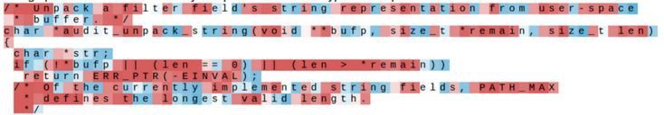
Searching for interpretable cells
Karpathy, Johnson, and Fei-Fei: Visualizing and Understanding Recurrent Networks, ICLR Workshop 2016 Figures copyright Karpathy, Johnson, and Fei-Fei, 2015; reproduced with permission
Fei-Fei Li, Jiajun Wu, Ruohan Gao

Slide 63
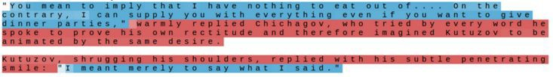
Searching for interpretable cells
quote detection cell
Karpathy, Johnson, and Fei-Fei: Visualizing and Understanding Recurrent Networks, ICLR Workshop 2016 Figures copyright Karpathy, Johnson, and Fei-Fei, 2015; reproduced with permission
Fei-Fei Li, Jiajun Wu, Ruohan Gao

Slide 64
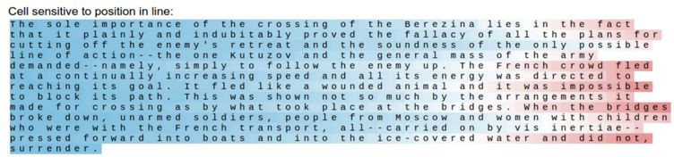
Searching for interpretable cells
line length tracking cell
Karpathy, Johnson, and Fei-Fei: Visualizing and Understanding Recurrent Networks, ICLR Workshop 2016 Figures copyright Karpathy, Johnson, and Fei-Fei, 2015; reproduced with permission
Fei-Fei Li, Jiajun Wu, Ruohan Gao

Slide 65
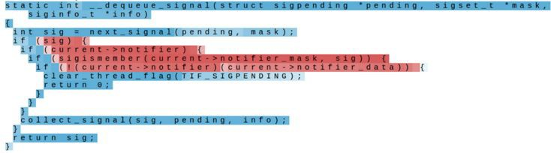
Searching for interpretable cells
if statement cell
Karpathy, Johnson, and Fei-Fei: Visualizing and Understanding Recurrent Networks, ICLR Workshop 2016 Figures copyright Karpathy, Johnson, and Fei-Fei, 2015; reproduced with permission
Fei-Fei Li, Jiajun Wu, Ruohan Gao

Slide 66
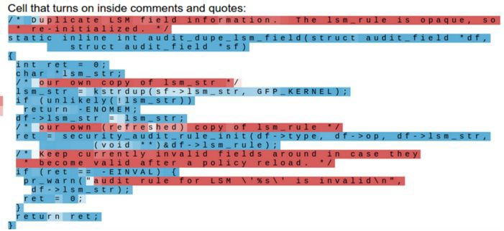
Searching for interpretable cells
quote/comment cell
Karpathy, Johnson, and Fei-Fei: Visualizing and Understanding Recurrent Networks, ICLR Workshop 2016
Figures copyright Karpathy, Johnson, and Fei-Fei, 2015; reproduced with permission
Fei-Fei Li, Jiajun Wu, Ruohan Gao
68

Slide 67
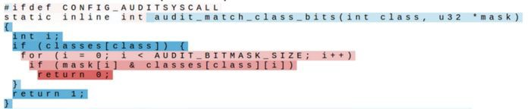
Searching for interpretable cells
code depth cell
Karpathy, Johnson, and Fei-Fei: Visualizing and Understanding Recurrent Networks, ICLR Workshop 2016 Figures copyright Karpathy, Johnson, and Fei-Fei, 2015; reproduced with permission
Fei-Fei Li, Jiajun Wu, Ruohan Gao

Slide 68
RNN tradeoffs
RNN Advantages:
Can process any length input
Computation for step t can (in theory) use information from many steps back
Model size doesn’t increase for longer input
Same weights applied on every timestep, so there is symmetry in how inputs are processed.
RNN Disadvantages:
Recurrent computation is slow
In practice, difficult to access information from many steps back
Fei-Fei Li, Jiajun Wu, Ruohan Gao

Slide 69
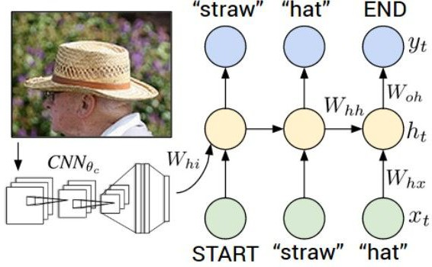
Image Captioning
Figure from Karpathy et a, “Deep
Visual-Semantic Alignments for Generating Image Descriptions”, CVPR 2015; figure copyright IEEE, 2015.
Reproduced for educational purposes.
Explain Images with Multimodal Recurrent Neural Networks, Mao et al.
Deep Visual-Semantic Alignments for Generating Image Descriptions, Karpathy and Fei-Fei Show and Tell: A Neural Image Caption Generator, Vinyals et al.
Long-term Recurrent Convolutional Networks for Visual Recognition and Description, Donahue et al. Learning a Recurrent Visual Representation for Image Caption Generation, Chen and Zitnick
Fei-Fei Li, Jiajun Wu, Ruohan Gao

Slide 70
Recurrent Neural Network
Convolutional Neural Network
Fei-Fei Li, Jiajun Wu, Ruohan Gao

Slide 71

test image
This image is CC0 public domain
Fei-Fei Li, Jiajun Wu, Ruohan Gao

Slide 72
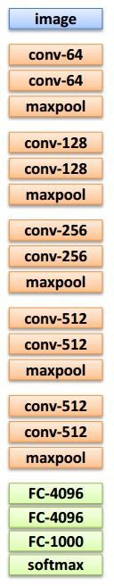
test image
Fei-Fei Li, Jiajun Wu, Ruohan Gao

Slide 73
test image
X
Fei-Fei Li, Jiajun Wu, Ruohan Gao

Slide 74
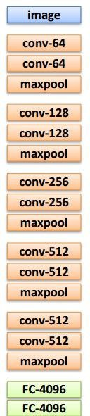
test image
x0
<START>
Fei-Fei Li, Jiajun Wu, Ruohan Gao

Slide 75
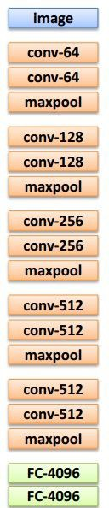

before:
test image
y0
h0
h = tanh(W_{xh} * x + W_{hh} * h)
Wih
now:
h = tanh(W_{xh} * x + W_{hh} * h + W_{ih} * v)
x0
<START>
Fei-Fei Li, Jiajun Wu, Ruohan Gao

Slide 76

test image
y0
h0
sample!
x0
<START>
straw
Fei-Fei Li, Jiajun Wu, Ruohan Gao

Slide 77
test image
y0
y1
h0
h1
x0
<START>
straw
Fei-Fei Li, Jiajun Wu, Ruohan Gao

Slide 78

test image
y0
y1
h0
h1
sample!
x0
<START>
straw
hat
Fei-Fei Li, Jiajun Wu, Ruohan Gao

Slide 79
test image
y0
y1
y2
h0
h1
h2
x0
<START>
straw
hat
Fei-Fei Li, Jiajun Wu, Ruohan Gao

Slide 80
test image
y0
y1
y2
sample
<END> token
=> finish.
h0
h1
h2
x0
<START>
straw
hat
Fei-Fei Li, Jiajun Wu, Ruohan Gao

Slide 81

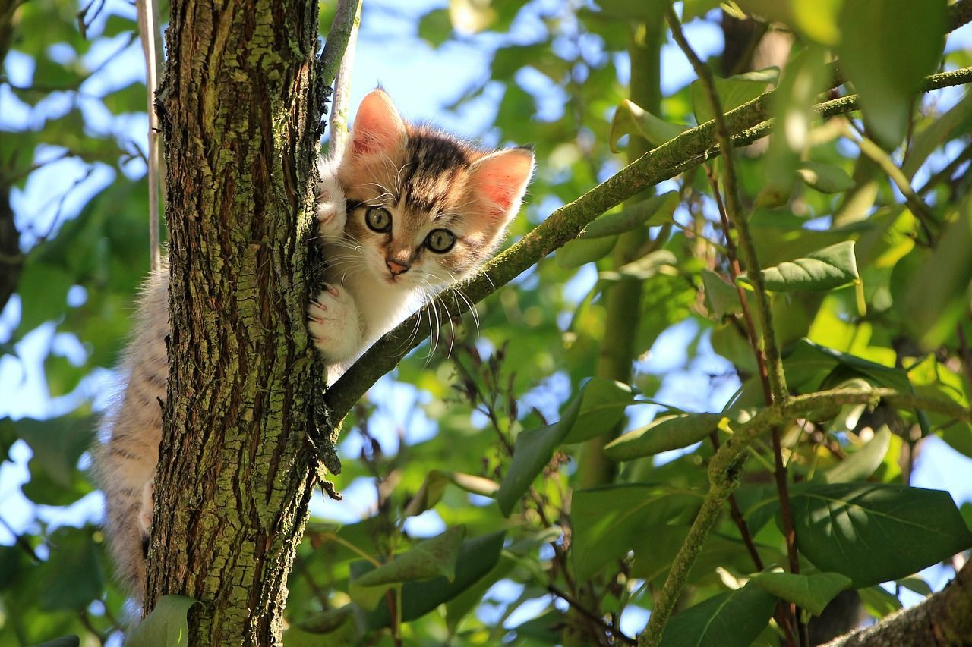
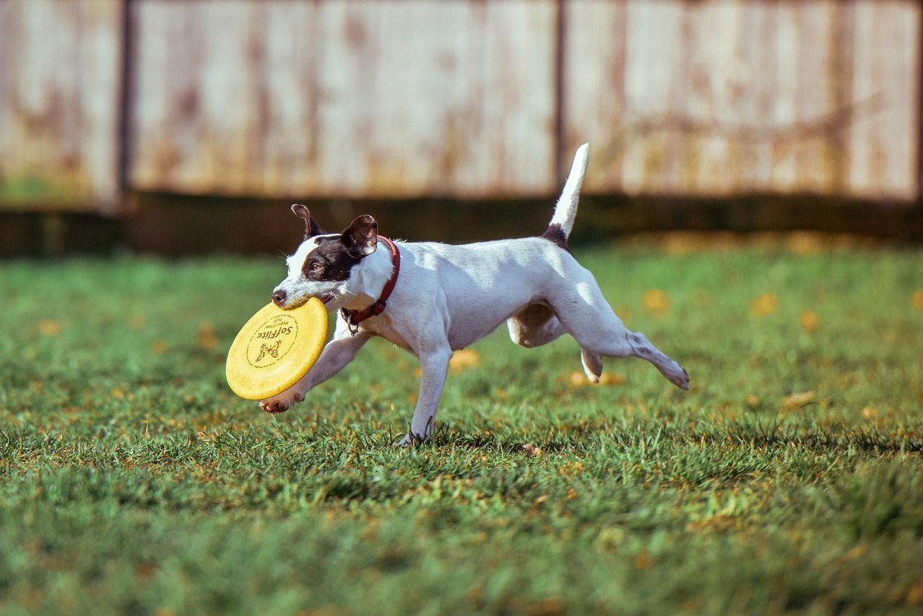


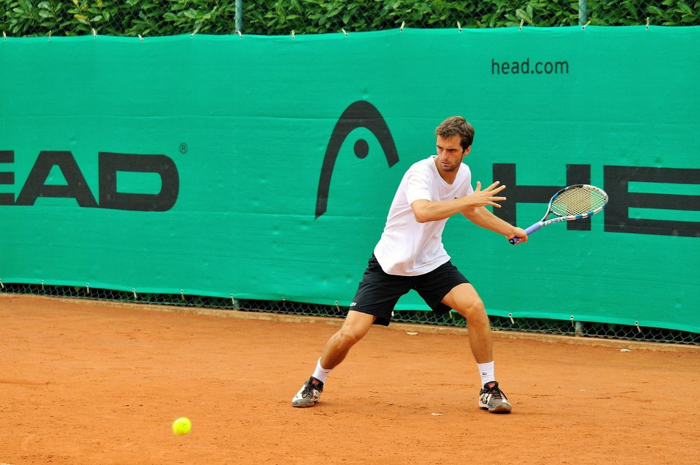
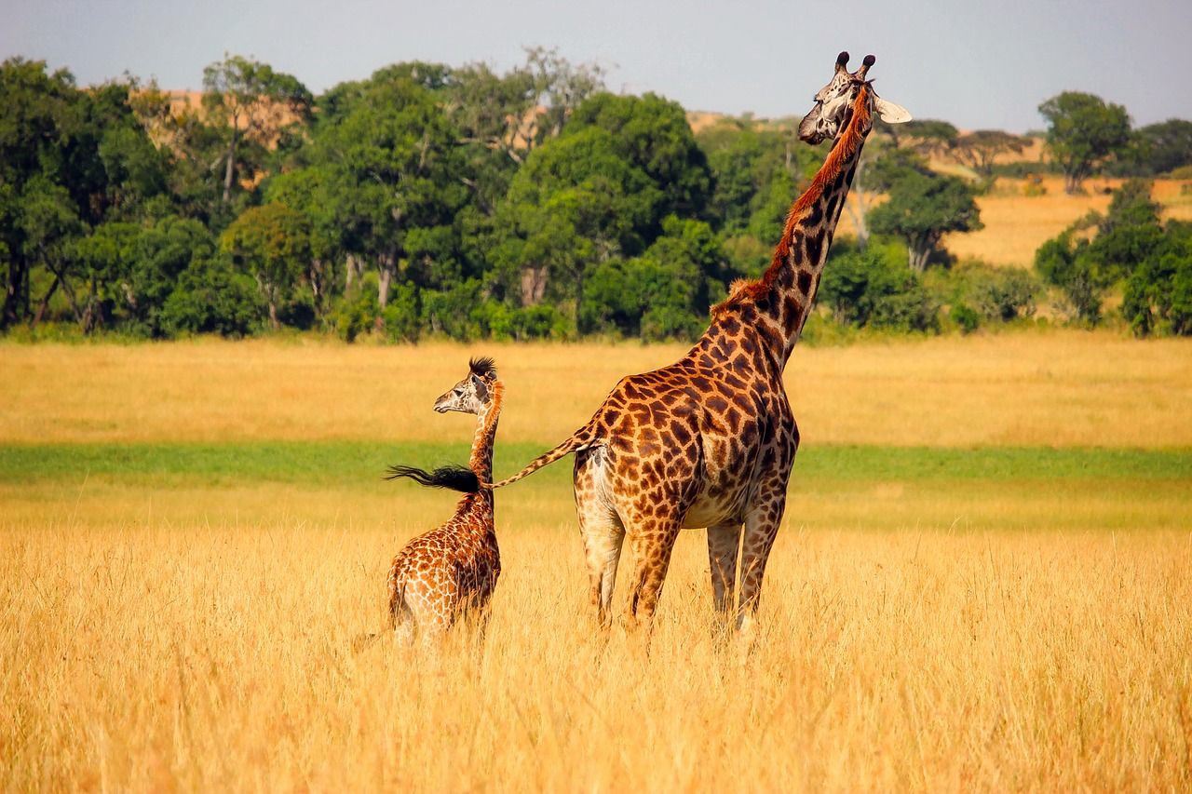
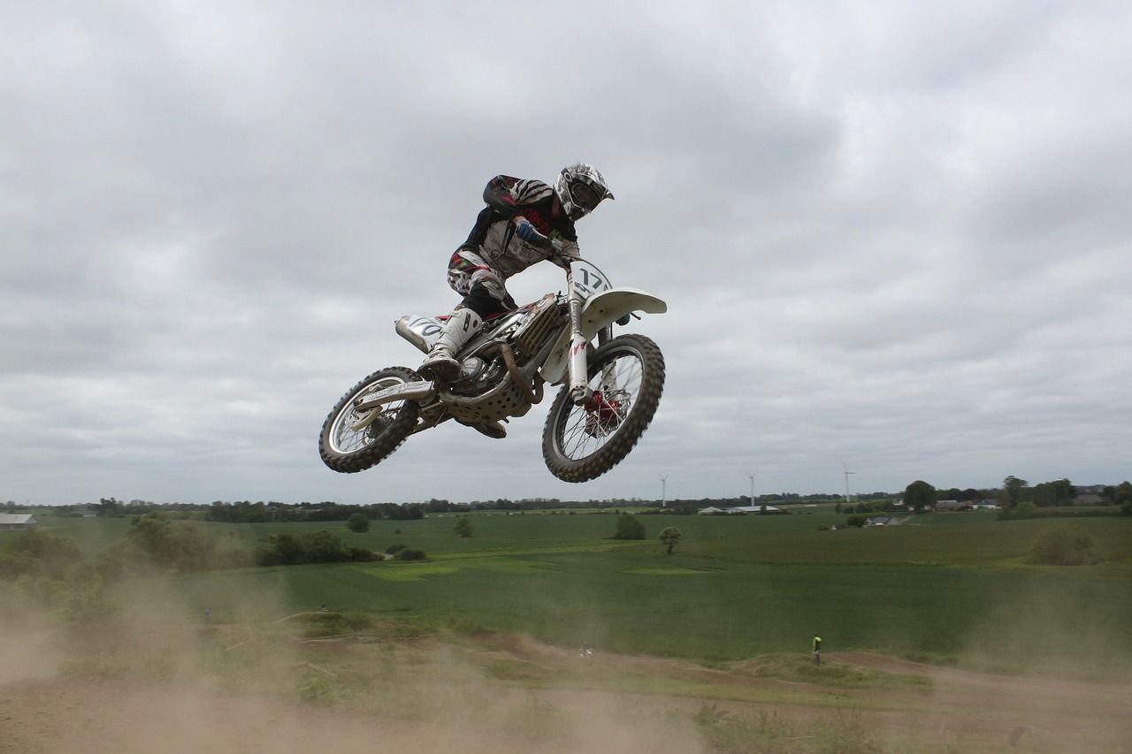
Image Captioning: Example Results
Captions generated using neuraltalk2 All images are CC0 Public domain: cat suitcase, cat tree, dog, bear, surfers, tennis, giraffe, motorcycle
A cat sitting on a suitcase on the floor
A cat is sitting on a tree branch
A dog is running in the grass with a frisbee
A white teddy bear sitting in the grass
Two people walking on the beach with surfboards
A tennis player in action on the court
Two giraffes standing in a grassy field
A man riding a dirt bike on a dirt track
Fei-Fei Li, Jiajun Wu, Ruohan Gao

Slide 82

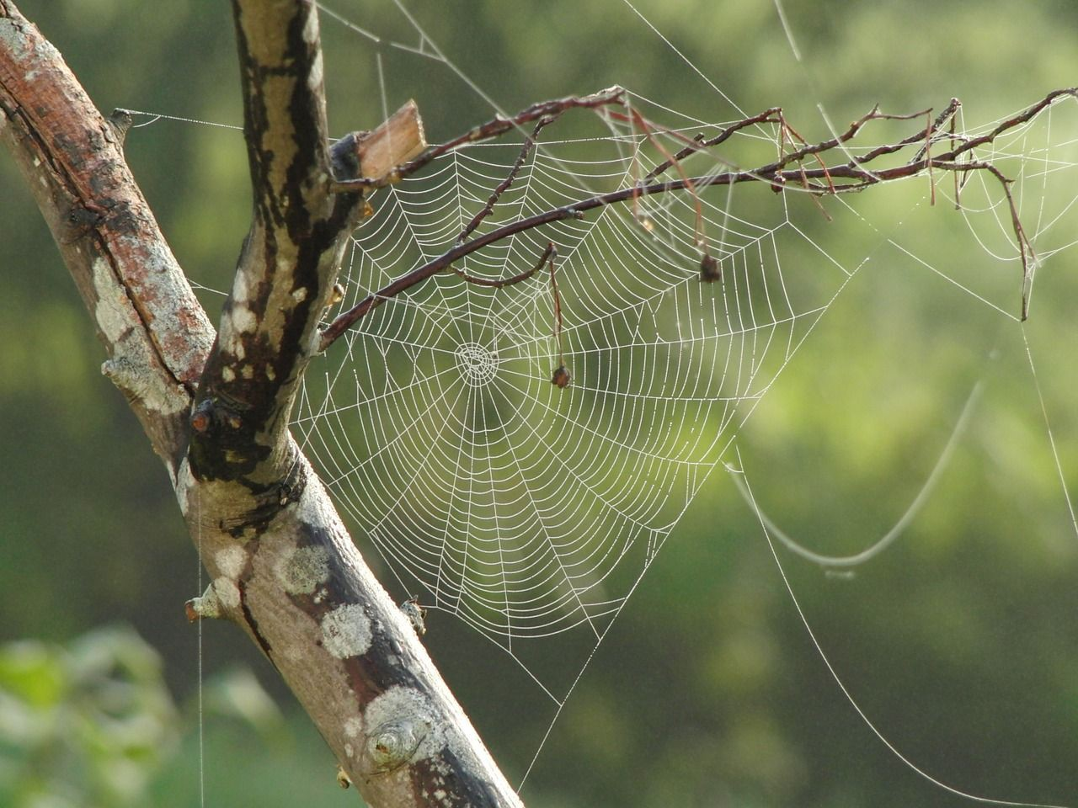



Image Captioning: Failure Cases
Captions generated using neuraltalk2 All images are CC0 Public domain: fur coat, handstand, spider web, baseball
A bird is perched on a tree branch
A woman is holding a cat in her hand
A man in a baseball uniform throwing a ball
A woman standing on a beach holding a surfboard
A person holding a computer mouse on a desk
Fei-Fei Li, Jiajun Wu, Ruohan Gao

Slide 83
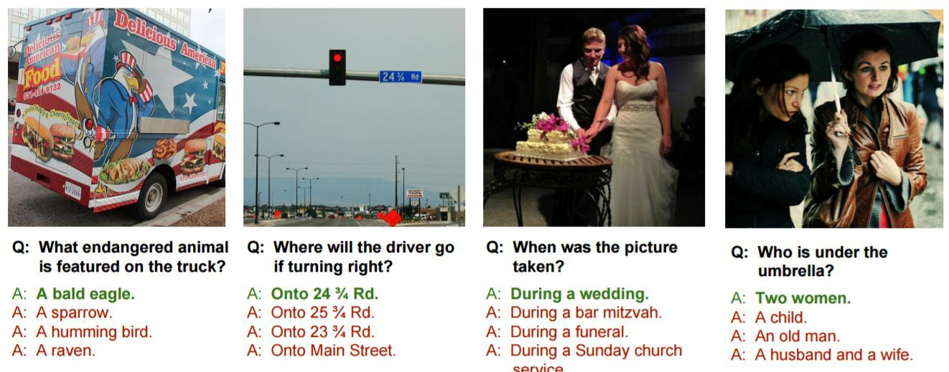
Visual Question Answering (VQA)
Agrawal et al, “VQA: Visual Question Answering”, ICCV 2015
Zhu et al, “Visual 7W: Grounded Question Answering in Images”, CVPR 2016
Figure from Zhu et al, copyright IEEE 2016. Reproduced for educational purposes.
Fei-Fei Li, Jiajun Wu, Ruohan Gao

Slide 84
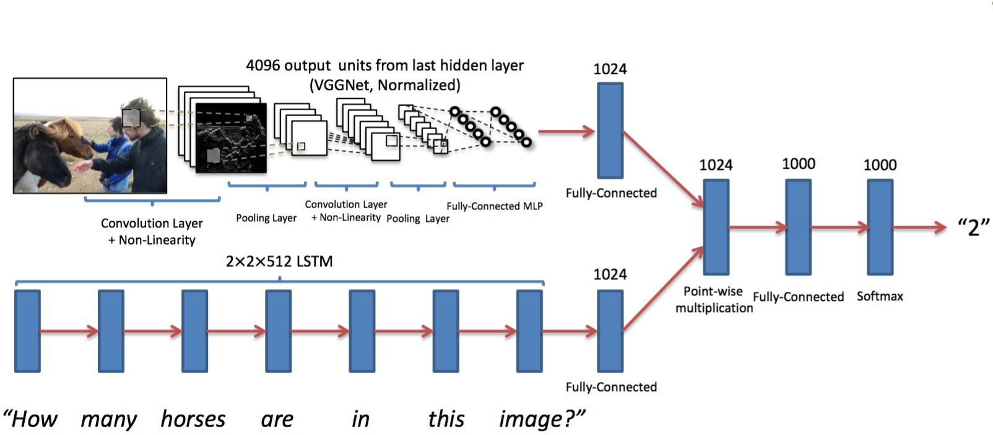
Visual Question Answering (VQA)
Agrawal et al, “Visual 7W: Grounded Question Answering in Images”, CVPR 2015
Figures from Agrawal et al, copyright IEEE 2015. Reproduced for educational purposes.
Fei-Fei Li, Jiajun Wu, Ruohan Gao

Slide 85
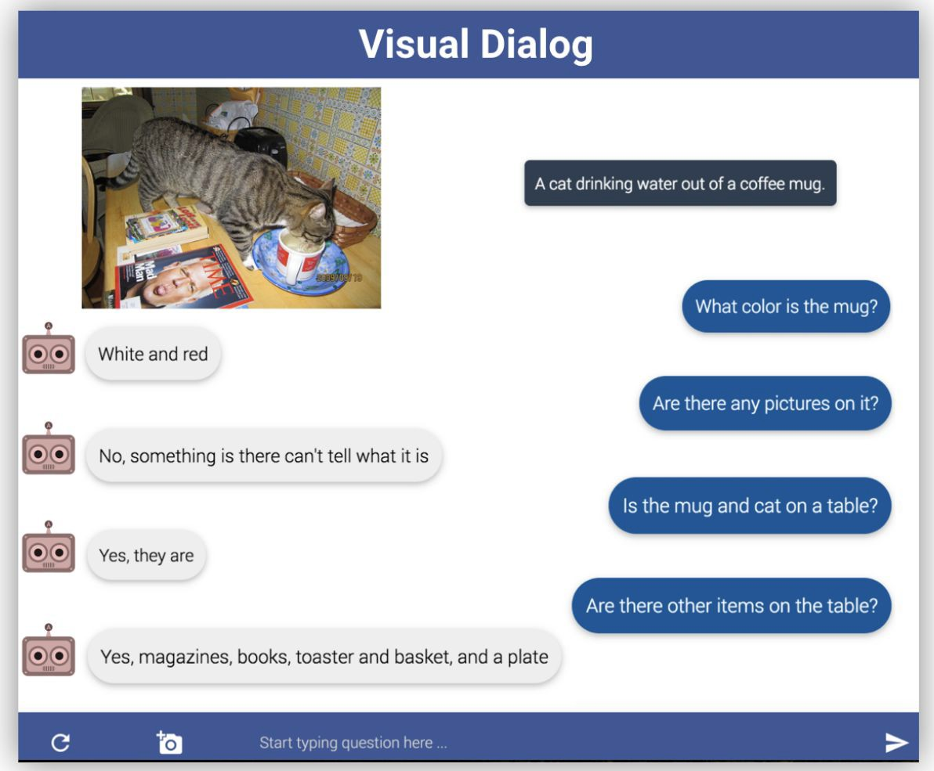
Visual Dialog: Conversations about images
Das et al, “Visual Dialog”, CVPR 2017
Figures from Das et al, copyright IEEE 2017. Reproduced with permission.
Fei-Fei Li, Jiajun Wu, Ruohan Gao

Slide 86

Visual Language Navigation: Go to the living room
Agent encodes instructions in language and uses an RNN to generate a series of movements as the visual input changes after each move.
Wang et al, “Reinforced Cross-Modal Matching and Self-Supervised Imitation Learning for Vision-Language Navigation”, CVPR 2018
Figures from Wang et al, copyright IEEE 2017. Reproduced with permission.
Fei-Fei Li, Jiajun Wu, Ruohan Gao

Slide 87

Visual Question Answering: Dataset Bias
All images are CC0 Public domain: dog,
Image
Model
What is the dog playing with?
Question
Yes or No
Frisbee
Answer
Jabri et al. “Revisiting Visual Question Answering Baselines” ECCV 2016
Fei-Fei Li, Jiajun Wu, Ruohan Gao

Slide 88
Multilayer RNNs
depth
time
Fei-Fei Li, Jiajun Wu, Ruohan Gao

Slide 89


Long Short Term Memory (LSTM)
Vanilla RNN LSTM
Hochreiter and Schmidhuber, “Long Short Term Memory”, Neural Computation 1997
Fei-Fei Li, Jiajun Wu, Ruohan Gao

Slide 90

Vanilla RNN Gradient Flow
Bengio et al, “Learning long-term dependencies with gradient descent is difficult”, IEEE Transactions on Neural Networks, 1994
Pascanu et al, “On the difficulty of training recurrent neural networks”, ICML 2013
y_{t}
W
tanh
stack
h_{t}
^{h}t-1
x_{t}
Fei-Fei Li, Jiajun Wu, Ruohan Gao

Slide 91
Vanilla RNN Gradient Flow
Bengio et al, “Learning long-term dependencies with gradient descent is difficult”, IEEE Transactions on Neural Networks, 1994
Pascanu et al, “On the difficulty of training recurrent neural networks”, ICML 2013
Backpropagation from h_{t} to h_{t-1} multiplies by W
y
(actually W
T₎
t
hh
W
tanh
stack
h_{t}
^{h}t-1
x_{t}
Fei-Fei Li, Jiajun Wu, Ruohan Gao

Slide 92

Vanilla RNN Gradient Flow
Bengio et al, “Learning long-term dependencies with gradient descent is difficult”, IEEE Transactions on Neural Networks, 1994
Pascanu et al, “On the difficulty of training recurrent neural networks”, ICML 2013
Backpropagation from h_{t} to h_{t-1} multiplies by W
y
(actually W
T₎
t
hh
W
tanh
stack
h_{t}
^{h}t-1
x_{t}
Fei-Fei Li, Jiajun Wu, Ruohan Gao

Slide 93


Vanilla RNN Gradient Flow
Bengio et al, “Learning long-term dependencies with gradient descent is difficult”, IEEE Transactions on Neural Networks, 1994
Pascanu et al, “On the difficulty of training recurrent neural networks”,
ICML 2013
y₃ y₄
y₁
y₂
h₀
h₁
h₂
h₃
h₄
x₁
x₂
x₃
x₄
Fei-Fei Li, Jiajun Wu, Ruohan Gao

Slide 94


Vanilla RNN Gradient Flow
Bengio et al, “Learning long-term dependencies with gradient descent is difficult”, IEEE Transactions on Neural Networks, 1994
Pascanu et al, “On the difficulty of training recurrent neural networks”,
ICML 2013
y₃ y₄
Gradients over multiple time steps:
y₁ y₂
h₀
h₁
h₂
h₃
h₄
x₁
x₂
x₃
x₄
Fei-Fei Li, Jiajun Wu, Ruohan Gao

Slide 95

Vanilla RNN Gradient Flow
Bengio et al, “Learning long-term dependencies with gradient descent is difficult”, IEEE Transactions on Neural Networks, 1994
Pascanu et al, “On the difficulty of training recurrent neural networks”,
ICML 2013
y₃ y₄
Gradients over multiple time steps:
y₁ y₂
h₀
h₁
h₂
h₃
h₄
x₁
x₂
x₃
x₄
Fei-Fei Li, Jiajun Wu, Ruohan Gao

Slide 96

Vanilla RNN Gradient Flow
Bengio et al, “Learning long-term dependencies with gradient descent is difficult”, IEEE Transactions on Neural Networks, 1994
Pascanu et al, “On the difficulty of training recurrent neural networks”,
ICML 2013
y₃ y₄
Gradients over multiple time steps:
y₁ y₂
h₀
h₁
h₂
h₃
h₄
x₁
x₂
x₃
x₄
Fei-Fei Li, Jiajun Wu, Ruohan Gao

Slide 97
Vanilla RNN Gradient Flow
Bengio et al, “Learning long-term dependencies with gradient descent is difficult”, IEEE Transactions on Neural Networks, 1994
Pascanu et al, “On the difficulty of training recurrent neural networks”,
ICML 2013
y₃ y₄
Gradients over multiple time steps:
y₁ y₂
h₀
h₁
h₂
h₃
h₄
x₁
x₂ x₃
Almost always < 1
Vanishing gradients
x₄
Fei-Fei Li, Jiajun Wu, Ruohan Gao

Slide 98
Vanilla RNN Gradient Flow
Bengio et al, “Learning long-term dependencies with gradient descent is difficult”, IEEE Transactions on Neural Networks, 1994
Pascanu et al, “On the difficulty of training recurrent neural networks”,
ICML 2013
y₃ y₄
Gradients over multiple time steps:
y₁ y₂
h₀
h₁
h₂
h₃
h₄
x₁
x₂
x₃
x₄
What if we assumed no non-linearity?
Fei-Fei Li, Jiajun Wu, Ruohan Gao

Slide 99

Vanilla RNN Gradient Flow
Bengio et al, “Learning long-term dependencies with gradient descent is difficult”, IEEE Transactions on Neural Networks, 1994
Pascanu et al, “On the difficulty of training recurrent neural networks”,
ICML 2013
y₃ y₄
Gradients over multiple time steps:
y₁ y₂
h₀
h₁
h₂
h₃
h₄
x₁
x₂ x₃
What if we assumed no non-linearity?
Largest singular value > 1:
Exploding gradients
x₄
Largest singular value < 1:
Vanishing gradients
Fei-Fei Li, Jiajun Wu, Ruohan Gao

Slide 100

Vanilla RNN Gradient Flow
Bengio et al, “Learning long-term dependencies with gradient descent is difficult”, IEEE Transactions on Neural Networks, 1994
Pascanu et al, “On the difficulty of training recurrent neural networks”,
ICML 2013
y₃ y₄
Gradients over multiple time steps:
y₁ y₂
h₀
h₁
h₂
h₃
h₄
x₁
x₂ x₃
What if we assumed no non-linearity?
x₄
Largest singular value > 1:
Exploding gradients
Gradient clipping: Scale gradient if its norm is too big
Largest singular value < 1:
Vanishing gradients
Fei-Fei Li, Jiajun Wu, Ruohan Gao

Slide 101
Vanilla RNN Gradient Flow
Bengio et al, “Learning long-term dependencies with gradient descent is difficult”, IEEE Transactions on Neural Networks, 1994
Pascanu et al, “On the difficulty of training recurrent neural networks”,
ICML 2013
y₃ y₄
Gradients over multiple time steps:
y₁ y₂
h₀
h₁
h₂
h₃
h₄
x₁
x₂ x₃
What if we assumed no non-linearity?
Largest singular value > 1:
Exploding gradients
x₄
Largest singular value < 1:
Vanishing gradients
Change RNN architecture
Fei-Fei Li, Jiajun Wu, Ruohan Gao

Slide 102
Long Short Term Memory (LSTM)
Vanilla RNN LSTM
Hochreiter and Schmidhuber, “Long Short Term Memory”, Neural Computation 1997
Fei-Fei Li, Jiajun Wu, Ruohan Gao

Slide 103
Long Short Term Memory (LSTM)
Vanilla RNN LSTM
Four gates
Cell state
Hidden state
Hochreiter and Schmidhuber, “Long Short Term Memory”, Neural Computation 1997
Fei-Fei Li, Jiajun Wu, Ruohan Gao

Slide 104
Long Short Term Memory (LSTM)
[Hochreiter et al., 1997]
vector from below (x)
W
x
sigmoid
i
h
sigmoid
f
vector from before (h)
sigmoid
o
tanh
g
4h x 2h
4h
4*h
Fei-Fei Li, Jiajun Wu, Ruohan Gao

Slide 105
Long Short Term Memory (LSTM)
[Hochreiter et al., 1997]
vector from below (x)
g: Gate gate (?), How much to write to cell
W
x
sigmoid
i
h
sigmoid
f
vector from before (h)
sigmoid
o
tanh
g
4h x 2h
4h
4*h
Fei-Fei Li, Jiajun Wu, Ruohan Gao

Slide 106
Long Short Term Memory (LSTM)
[Hochreiter et al., 1997]
i: Input gate, whether to write to cell
vector from below (x)
g: Gate gate (?), How much to write to cell
W
x
sigmoid
i
h
sigmoid
f
vector from before (h)
sigmoid
o
tanh
g
4h x 2h
4h
4*h
Fei-Fei Li, Jiajun Wu, Ruohan Gao

Slide 107
Long Short Term Memory (LSTM)
[Hochreiter et al., 1997]
i: Input gate, whether to write to cell
f: Forget gate, Whether to erase cell
vector from below (x)
g: Gate gate (?), How much to write to cell
W
x
sigmoid
i
h
sigmoid
f
vector from before (h)
sigmoid
o
tanh
g
4h x 2h
4h
4*h
Fei-Fei Li, Jiajun Wu, Ruohan Gao

Slide 108
Long Short Term Memory (LSTM)
[Hochreiter et al., 1997]
i: Input gate, whether to write to cell
f: Forget gate, Whether to erase cell
o: Output gate, How much to reveal cell
vector from below (x)
g: Gate gate (?), How much to write to cell
W
x
sigmoid
i
h
sigmoid
f
vector from before (h)
sigmoid
o
tanh
g
4h x 2h
4h
4*h
Fei-Fei Li, Jiajun Wu, Ruohan Gao

Slide 109
Long Short Term Memory (LSTM)
[Hochreiter et al., 1997]
☉
+
c_{t}
^{c}t-1
f i g
W
☉
tanh
^{h}t-1
stack
o
☉
h_{t}
x_{t}
Fei-Fei Li, Jiajun Wu, Ruohan Gao

Slide 110
Long Short Term Memory (LSTM): Gradient Flow
[Hochreiter et al., 1997]
Backpropagation from c_{t} to
c_{t-1} only elementwise multiplication by f, no matrix multiply by W
c
☉ +
c
t-1
t
f i g
W
☉
tanh
^{h}t-1
stack
o
☉
h_{t}
x_{t}
Fei-Fei Li, Jiajun Wu, Ruohan Gao

Slide 111

Long Short Term Memory (LSTM): Gradient Flow
[Hochreiter et al., 1997]
Uninterrupted gradient flow!
c₀ c₁ c₂
c₃
Notice that the gradient contains the f gate’s vector of activations
allows better control of gradients values, using suitable parameter updates of the forget gate.
Also notice that are added through the f, i, g, and o gates
better balancing of gradient values
Fei-Fei Li, Jiajun Wu, Ruohan Gao

Slide 112
Do LSTMs solve the vanishing gradient problem?
The LSTM architecture makes it easier for the RNN to preserve information over many timesteps
e.g. if the f = 1 and the i = 0, then the information of that cell is preserved indefinitely.
By contrast, it’s harder for vanilla RNN to learn a recurrent weight matrix Wh that preserves info in hidden state
LSTM doesn’t guarantee that there is no vanishing/exploding gradient, but it does provide an easier way for the model to learn long-distance dependencies
Fei-Fei Li, Jiajun Wu, Ruohan Gao

Slide 113
Long Short Term Memory (LSTM): Gradient Flow
[Hochreiter et al., 1997]
Uninterrupted gradient flow!
c₀ c₁ c₂
c₃
Similar to ResNet!
3x3 conv, 128
3x3 conv, 128
3x3 conv, 128
3x3 conv, 128
3x3 conv, 128
3x3 conv, 128 / 2
3x3 conv, 64
3x3 conv, 64
3x3 conv, 64
3x3 conv, 64
3x3 conv, 64
3x3 conv, 64
Pool
7x7 conv, 64 / 2 Input
Softmax FC 1000
Pool
3x3 conv, 64
3x3 conv, 64
3x3 conv, 64
3x3 conv, 64
3x3 conv, 64
3x3 conv, 64
...
Fei-Fei Li, Jiajun Wu, Ruohan Gao

Slide 114

Long Short Term Memory (LSTM): Gradient Flow
[Hochreiter et al., 1997]
Uninterrupted gradient flow!
c₀ c₁ c₂
c₃
In between:
Highway Networks
Similar to ResNet!
3x3 conv, 128
3x3 conv, 128
3x3 conv, 128
3x3 conv, 128
3x3 conv, 128
3x3 conv, 128 / 2
3x3 conv, 64
3x3 conv, 64
3x3 conv, 64
3x3 conv, 64
3x3 conv, 64
3x3 conv, 64
Pool
7x7 conv, 64 / 2 Input
Softmax FC 1000
Pool
3x3 conv, 64
3x3 conv, 64
3x3 conv, 64
3x3 conv, 64
3x3 conv, 64
3x3 conv, 64
...
Srivastava et al, “Highway Networks”, ICML DL Workshop 2015
Fei-Fei Li, Jiajun Wu, Ruohan Gao

Slide 115


Other RNN Variants
[An Empirical Exploration of Recurrent Network Architectures, Jozefowicz et al., 2015]
GRU [Learning phrase representations using rnn encoder-decoder for statistical machine translation, Cho et al. 2014]
[LSTM: A Search Space Odyssey, Greff et al., 2015]
Fei-Fei Li, Jiajun Wu, Ruohan Gao

Slide 116

Neural Architecture Search for RNN architectures
LSTM cell
Cell they found
Zoph et Le, “Neural Architecture Search with Reinforcement Learning”, ICLR 2017
Figures copyright Zoph et al, 2017. Reproduced with permission.
Fei-Fei Li, Jiajun Wu, Ruohan Gao

Slide 117
Summary
RNNs allow a lot of flexibility in architecture design
Vanilla RNNs are simple but don’t work very well
Common to use LSTM or GRU: their additive interactions improve gradient flow
Backward flow of gradients in RNN can explode or vanish. Exploding is controlled with gradient clipping. Vanishing is controlled with additive interactions (LSTM)
Better/simpler architectures are a hot topic of current research, as well as new paradigms for reasoning over sequences
Better understanding (both theoretical and empirical) is needed.
Fei-Fei Li, Jiajun Wu, Ruohan Gao

Slide 118
Next time: Attention and Transformers
Fei-Fei Li, Jiajun Wu, Ruohan Gao

Slide 119
Thank You

